Slide 1

Git & Github

Slide 2
Module 2 Content:
The 3-staged Workflow
Git workflow
Essential Git commands
Tracked vs Untracked Files
Visualizing Changes & .gitignore

Slide 3
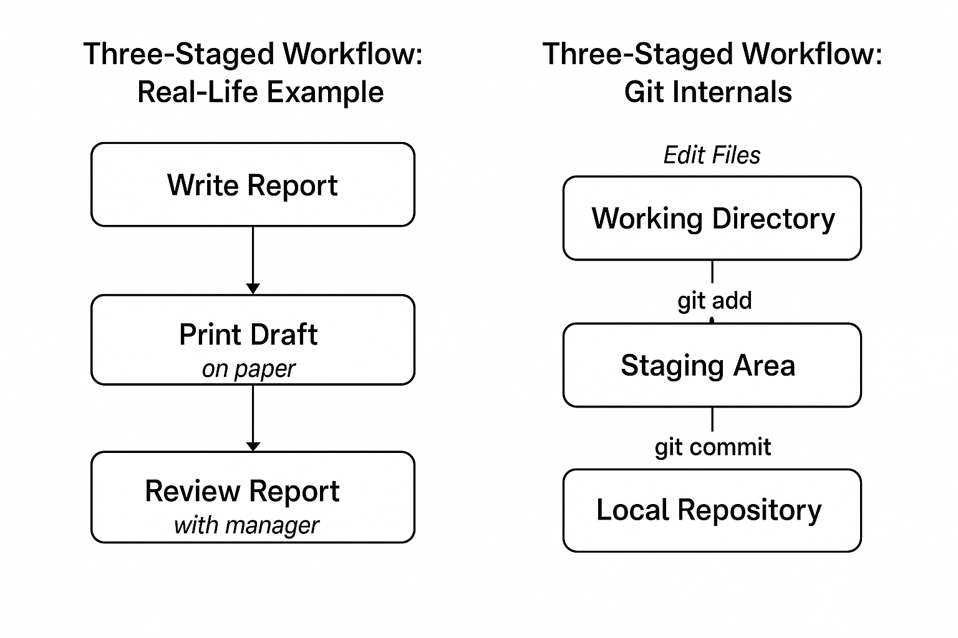
The 3-staged Workflow

Slide 4
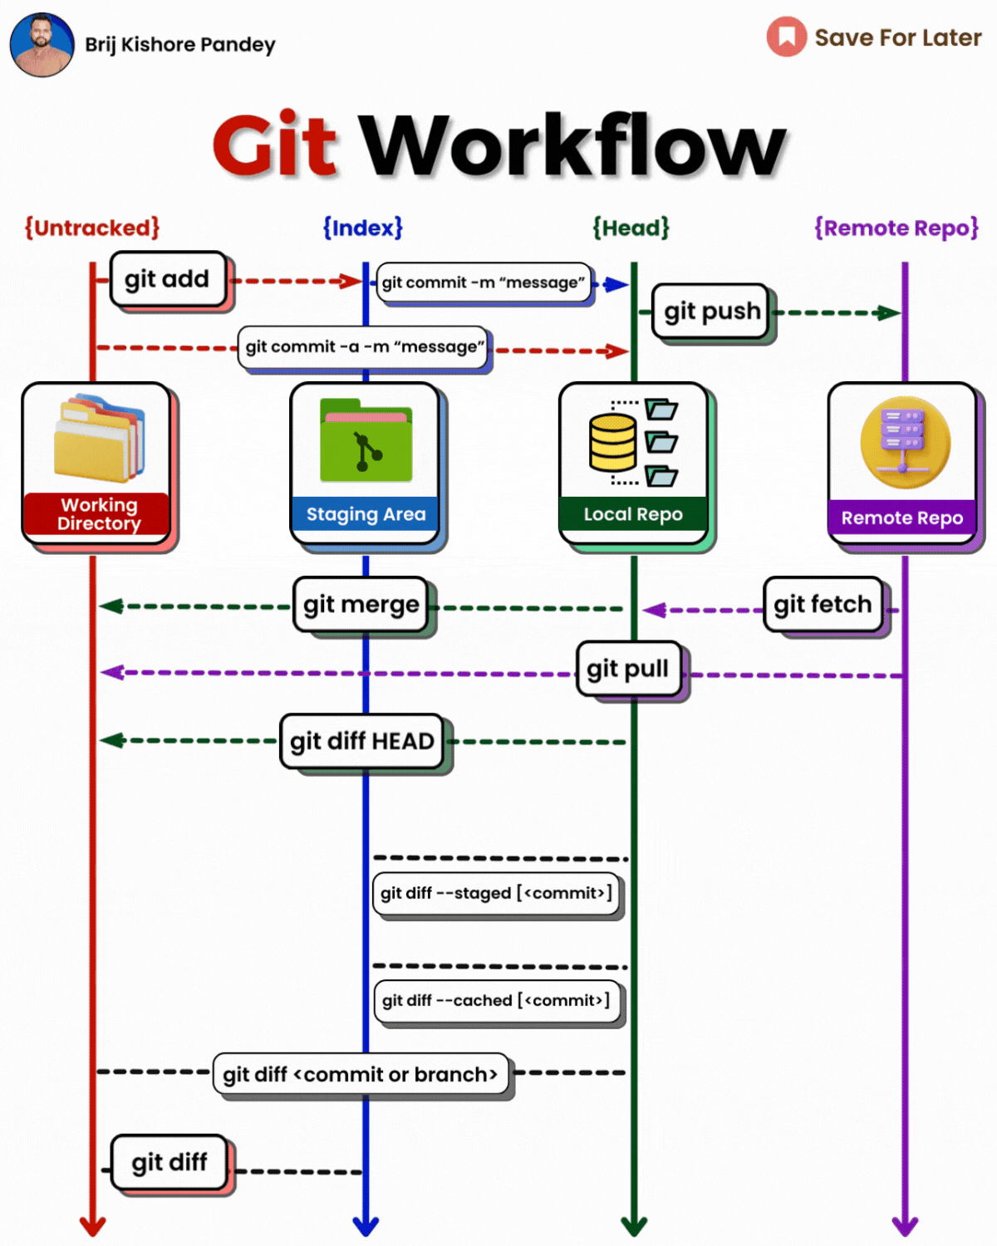
Notes:
Think of Git as your automatic time machine and team manager. It remembers every change, who made it, and lets you jump back in time — without all those messy filenames.”

Slide 5
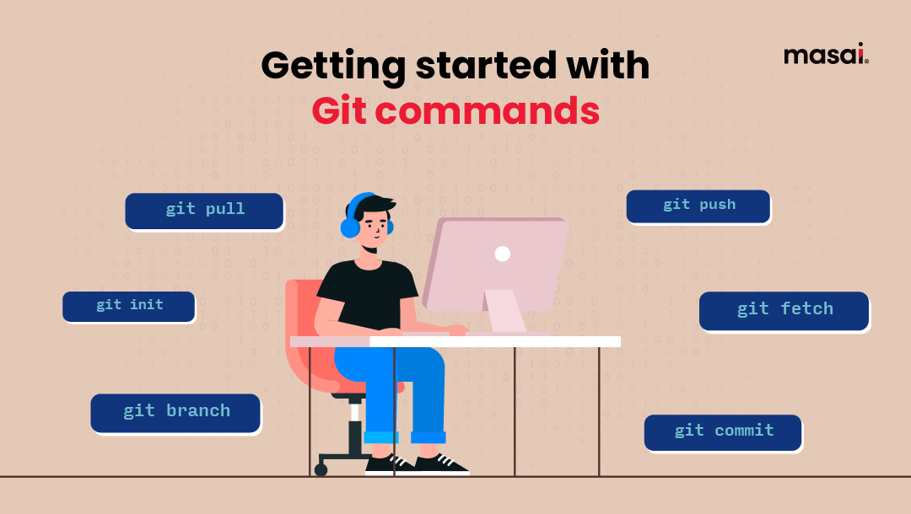
Essential Git commands:

Slide 6
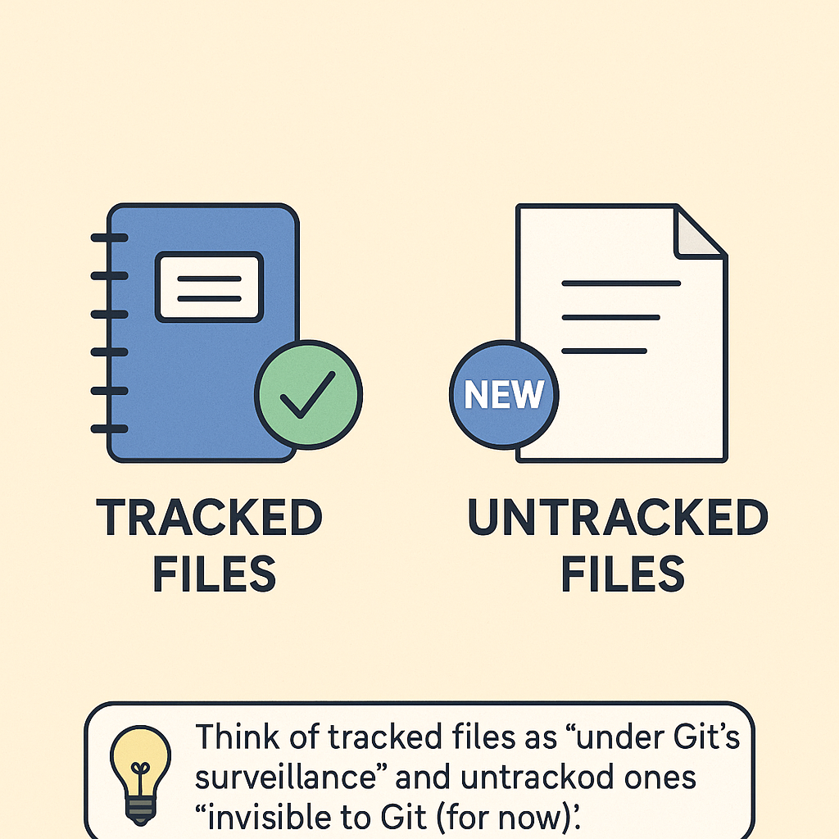
Tracked Vs Untracked Files:
Tracked Files:
Git is watching and managing these files
All changes will be recorded after each commit
Includes files you have added and committed before
Untracked Files:
Git doesn’t know about them yet
They are new files you created but haven’t added to Git
You need to run git add to start tracking them

Slide 7
Git Graph
Shows a visual timeline of all commits and branches
Helps you understand how your project has evolved over time
Makes it easy to spot merges, branches and commit messages
Tools: git log –graph, Git Graph extension (in VS Code)
Notes:
Git helps you track your own project changes on your computer. But when you want to show your project to the world or work with others, you upload it to GitHub. It’s like turning your private notebook into a public or shared notebook in the cloud

